Slide 1
-Computer Vision-
Aircraft and other Vehicles
Lex Kim, Hylene Wu, Neel Jay, Jordan Maggin, Zhuo Cheng Xie
Notes:
1. Functionality: Does the team present a working application that meets the project requirements? Make sure to include your initial goals (as stated in the proposal) and highlight what you have achieved on the poster.
2. Comprehensive Overview: Does the poster provide a thorough and well-structured overview of the project, including its objectives, methodology, and outcomes?
3. Quality of Results: Are the results presented accurate, well-organized, and easy to understand? Do they effectively demonstrate the project's achievements?
4. Clarity of Communication: Can the team effectively communicate the key aspects of their project to the audience? Are they able to answer questions and provide additional insights?
5. (Bonus) Extra Effort and Insight: Does the team demonstrate additional effort or insight beyond the basic project requirements, such as conducting extra research, implementing advanced features, or providing thoughtful analysis?
Poster presentation guidelines
- Please arrive early, and set up your poster by 9:30 am.
- Late posters won't be graded.
- Bring masking tape or double-sided tape to mount your poster.
- You can take the quiz from any section. It will be open at a random time.

Slide 2
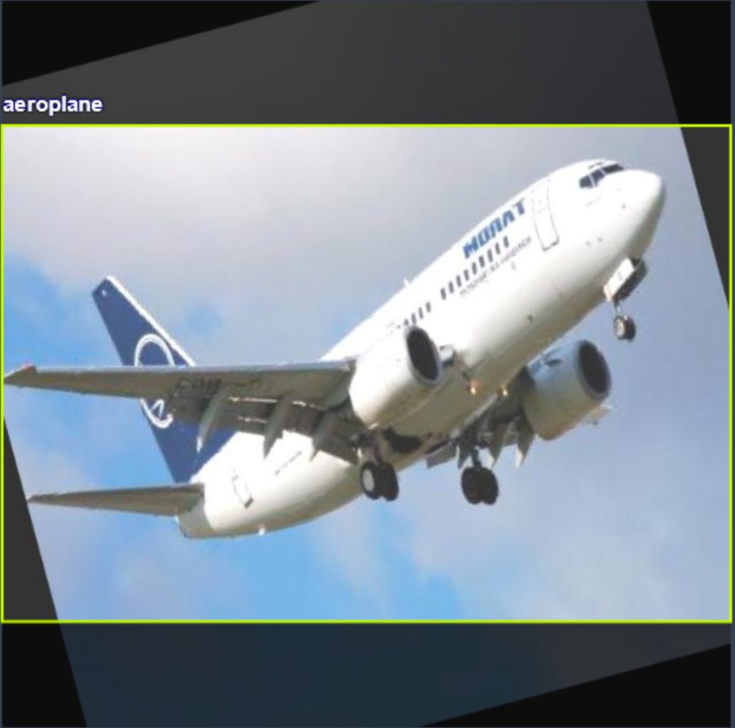
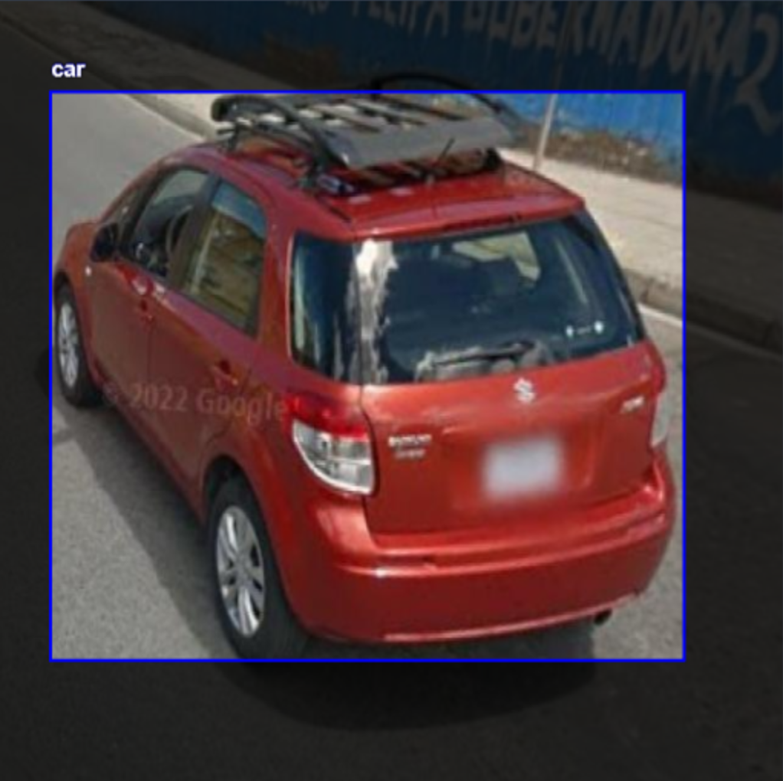
Objectives
Initial goal: Create an image classification program based on YOLO that attempts to locate airplanes in images
Continuation: Build up on previous program by introducing other vehicles (cars, trucks, helicopters)

Slide 3
Methodology
Researched architecture best suited for our goal (YOLOv8, OpenCV)
Gathered various datasets to test and train the model with (Roboflow, Kaggle)
Compiled datasets onto our Roboflow workspace
Trained the YOLOv8 model on our datasets (via Google Colab)
Created a working GUI with a basic file viewer to apply the model to locally-saved images

Slide 4
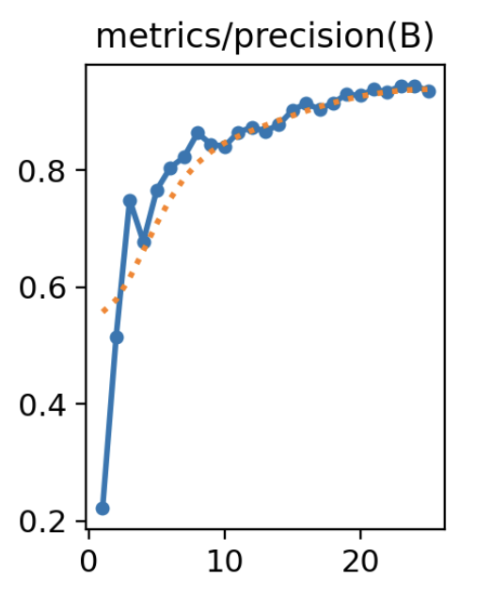
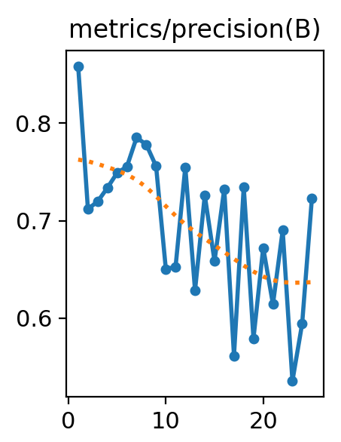
Outcomes
<- precision graph for Plane Detection
Aircraft Detection Model
Achieved ~93% precision
Vehicles and Aircraft Detection Model
Achieved ~59% precision
Extra features: functional GUI
precision graph -> for vehicle detection

Slide 5
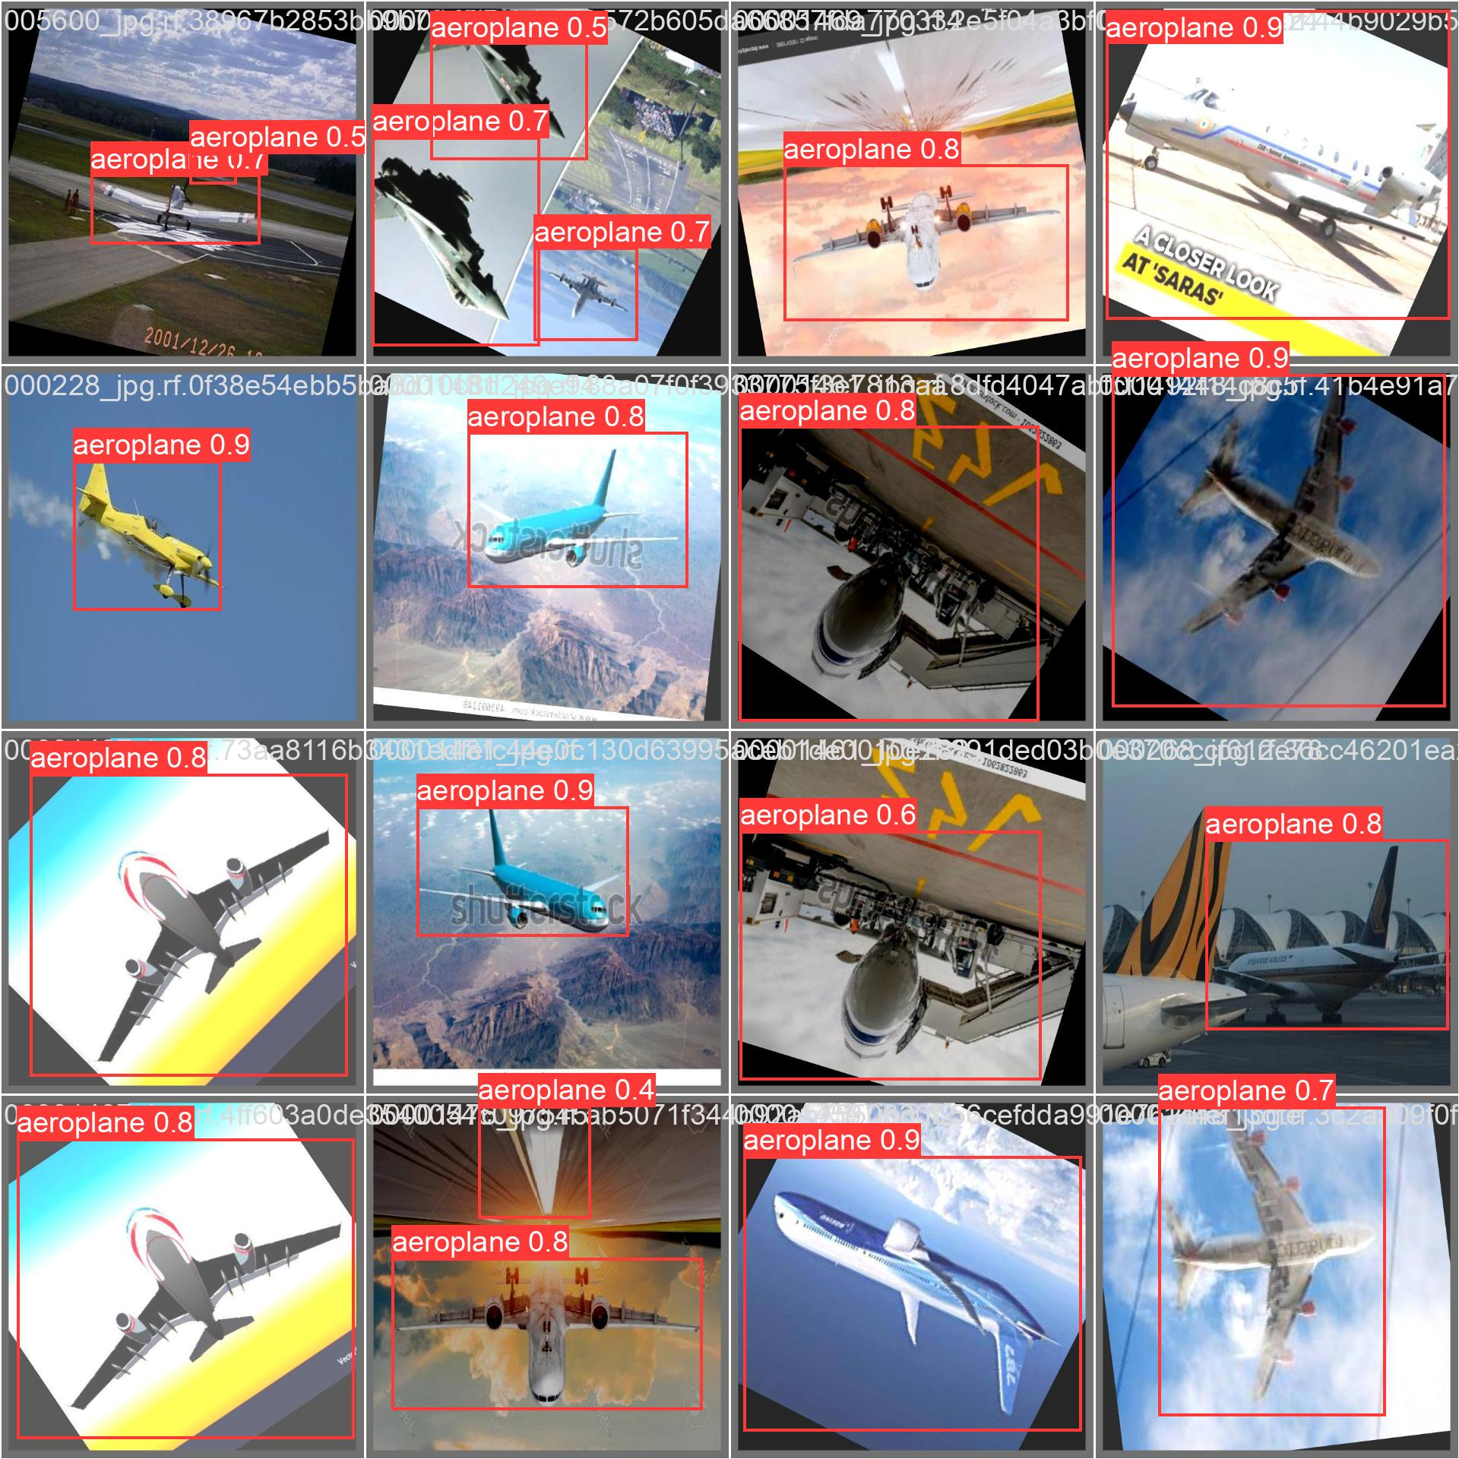
Model on Aircrafts

Slide 6
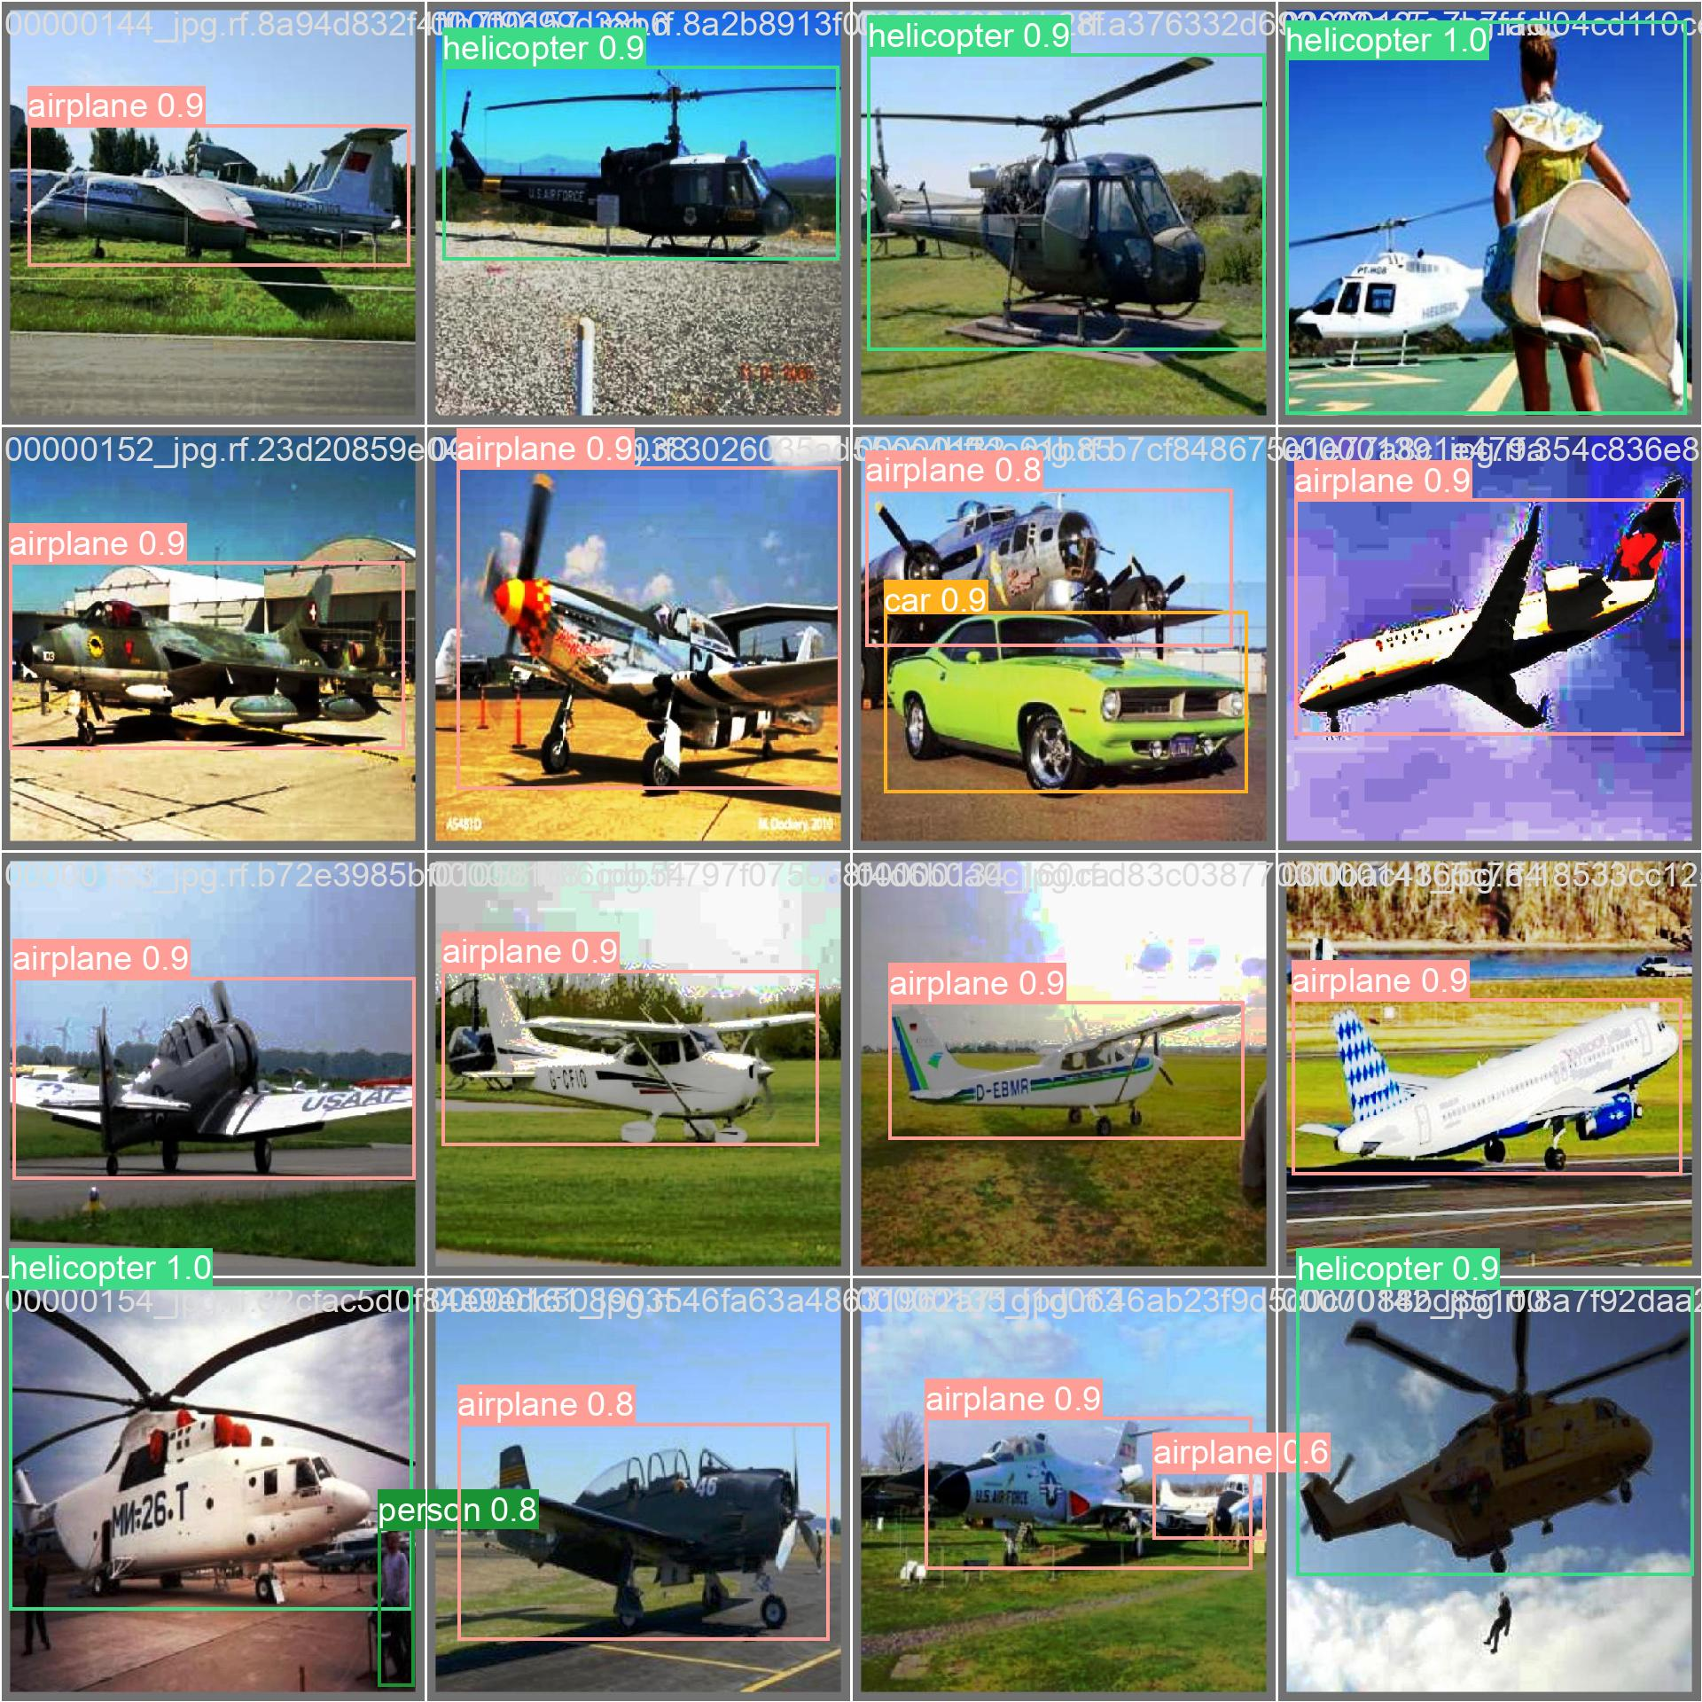
Model on Multiple Vehicle Classes

Slide 7
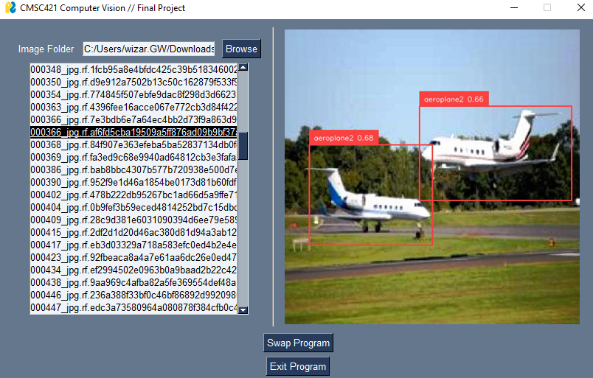
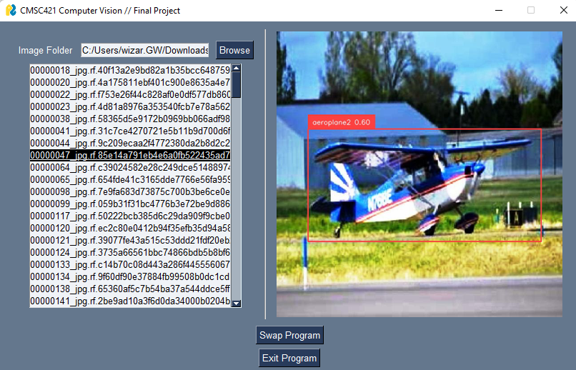
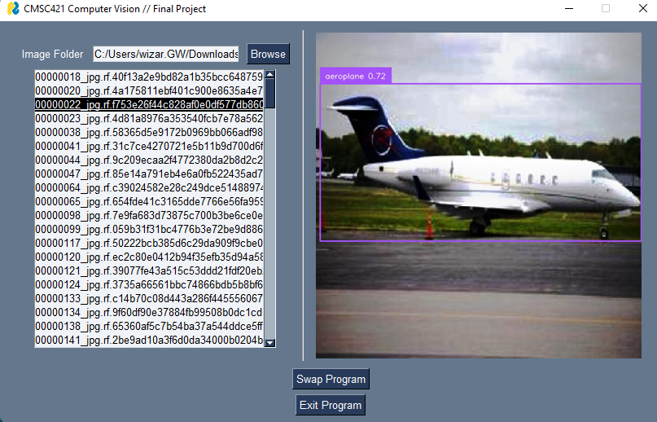
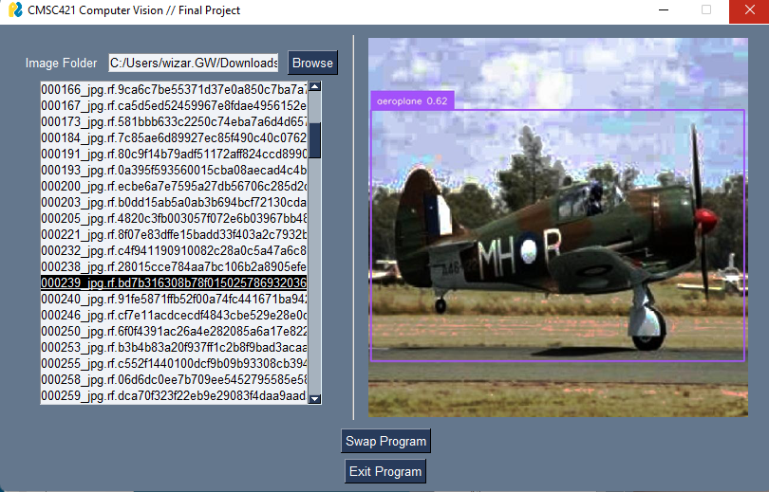
Examples for model output with GUI

Slide 8
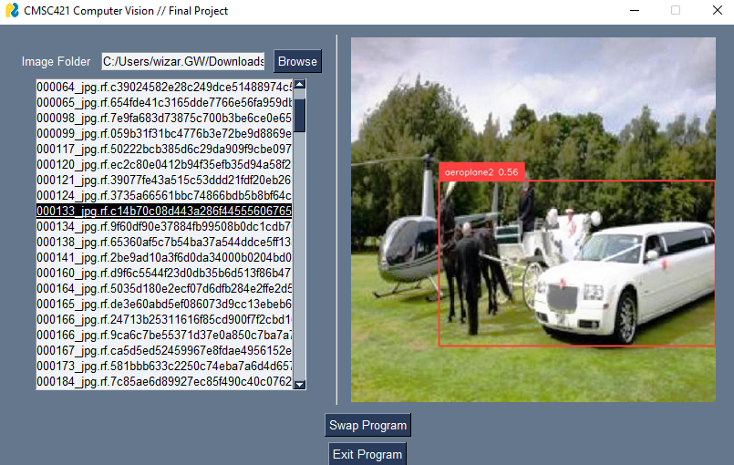
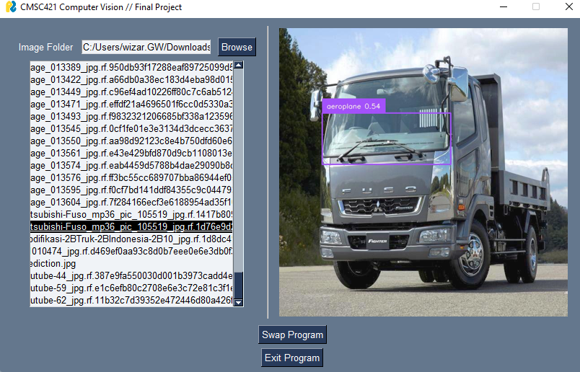
For Fun:
Model Messups!

Slide 9


References
Links to Online Deployment (Roboflow workspace):
Plane detection/tracking: → https://app.roboflow.com/cmsc421-final-project/plane-detection-eyzak/visualize/2
Vehicle detection/classification: https://app.roboflow.com/cmsc421-final-project/vehicle-detection-ansgq/visualize/1 →
Example video link: (copy and paste link into model)
https://www.youtube.com/watch?v=1Lqjy25ZBDc&t=58s&ab_channel=AirshowWorld

